Slide 1



Academic Session 2020-21 (Even Semester)
Department of Computer Engineering

Slide 2

Self-Introduction
Name: Deepak Moud
Qualification: BE, MTECH, PhD(Persuing)
Designation: Head of Department
Research Area: Image Processing, Machine Learning, Deep learning, data Mining
E-mail Id: deepakmoud@poornima.org
Phone Number: 07568748510

Slide 3

Syllabus

Slide 4
Books
Sr. No. | Title of the book | Author
1 | Machine Learning | Anuradha Srinivasaraghavan, Vincy Joseph
2 | Data Mining Concepts and Techniques | Jiawei Han University of Illinois at Urbana–Champaign Micheline Kamber Jian Pei Simon Fraser University

Slide 5
This document contains images obtained by routine Google Images searches. Some of these images may perhaps be under copyright. They are included here for educational and noncommercial purposes and are considered to be covered by the doctrine of Fair Use. In any event they are easily available from Google Images.
Public Notice regarding Use of Images
It's not feasible to give full scholarly credit to the creators of these images. We hope they can be satisfied with the positive role they are playing in the educational process.
2

Slide 6

Introduction to Deep Learning and Neural Network

Slide 7
Outline
Machine Learning basics
Introduction to Deep Learning
what is Deep Learning
why is it useful
Neural Network:
activation functions
optimizers, cost functions and training
regularization methods
Tuning
Implementation

Slide 8
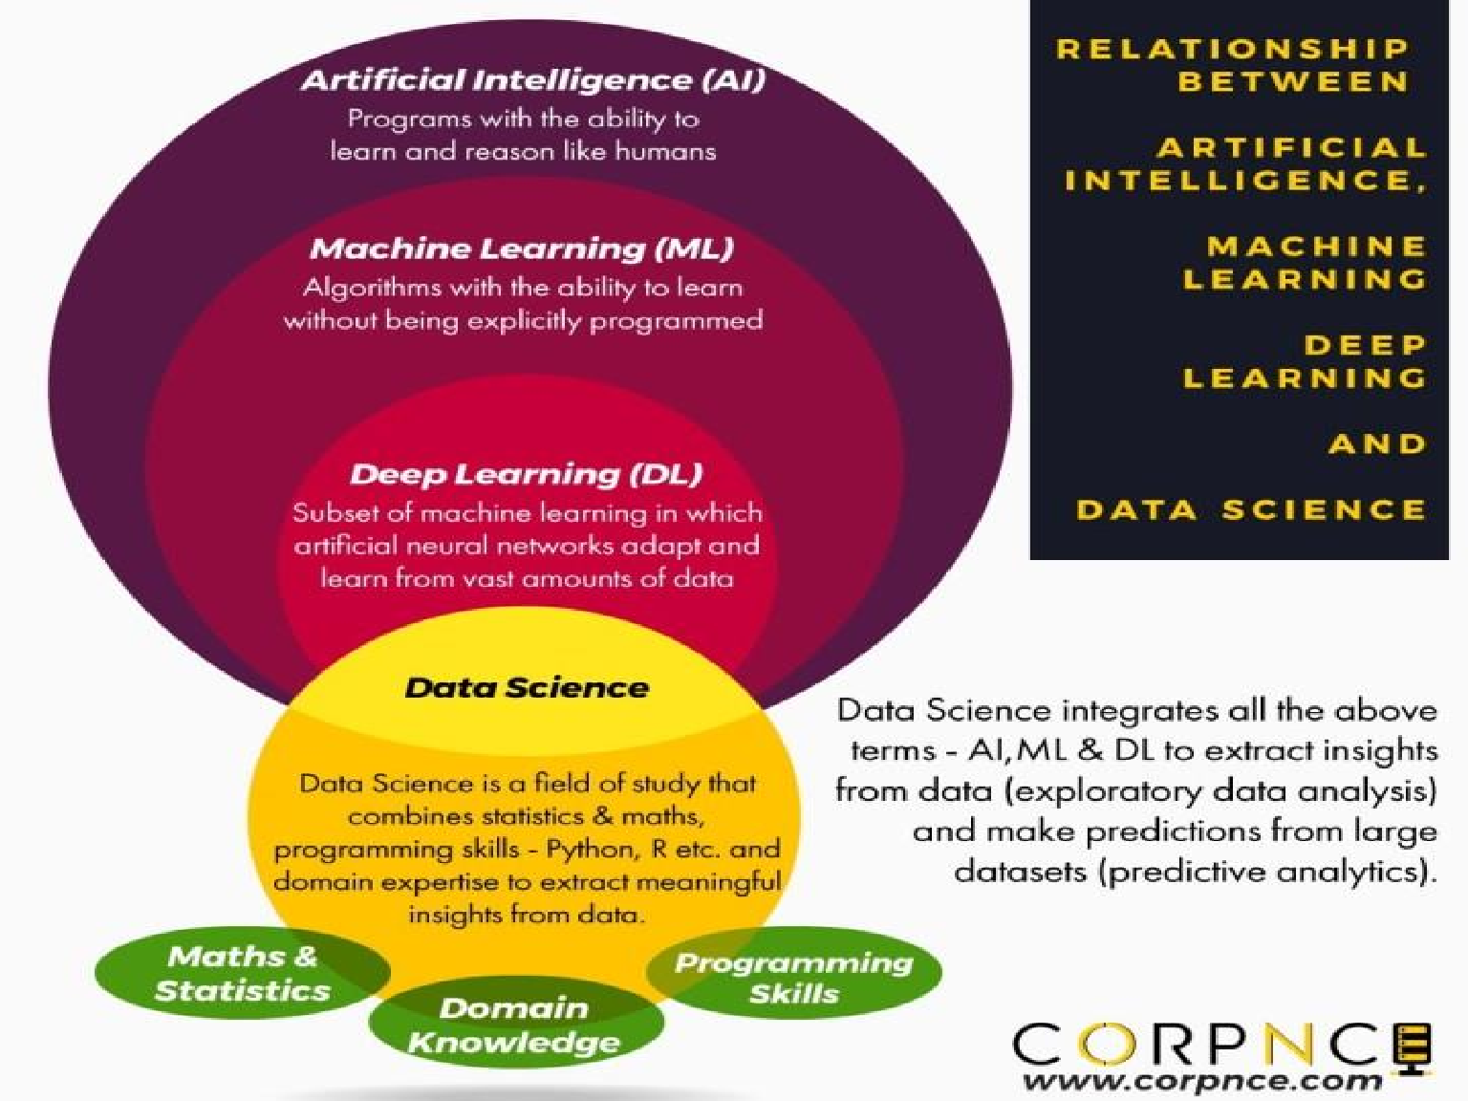

Slide 9
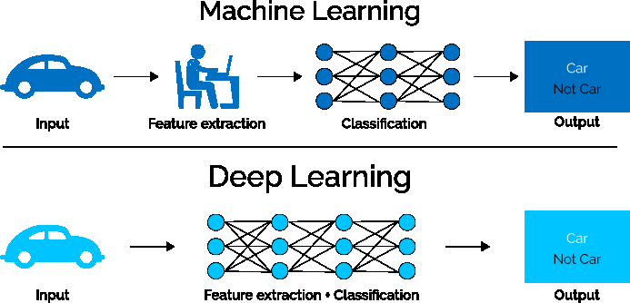
What is Deep Learning (DL) ?
A machine learning subfield of learning representations of data. Exceptional effective at learning patterns.
Deep learning algorithms attempt to learn (multiple levels of) representation by using a hierarchy of multiple layers
If you provide the system tons of information, it begins to understand it and
respond in useful ways.
https://www.xenonstack.com/blog/static/public/uploads/media/machine-learning-vs-deep-learning.png

Slide 10
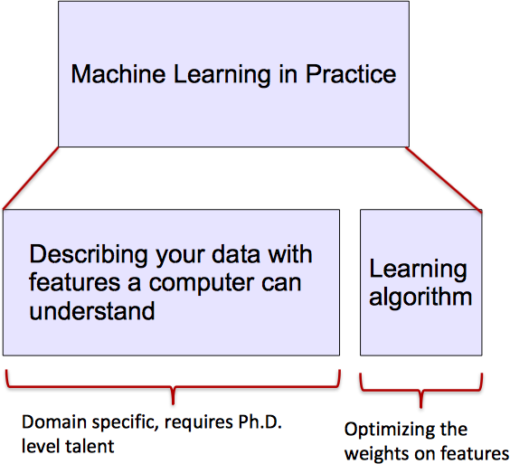
ML vs. Deep Learning
Most machine learning methods work well because of human-designed representations and input features
ML becomes just optimizing weights to best make a final prediction

Slide 11
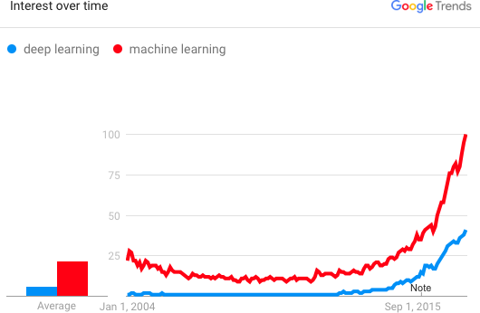
Why is DL useful?
Manually designed features are often over-specified, incomplete and take a long time to design and validate
Learned Features are easy to adapt, fast to learn
Deep learning provides a very flexible, (almost?) universal, learnable
framework for representing world, visual and linguistic information.
Can learn both unsupervised and supervised
Effective end-to-end joint system learning
Utilize large amounts of training data
In ~2010 DL started outperforming other ML techniques
first in speech and vision, then NLP

Slide 12
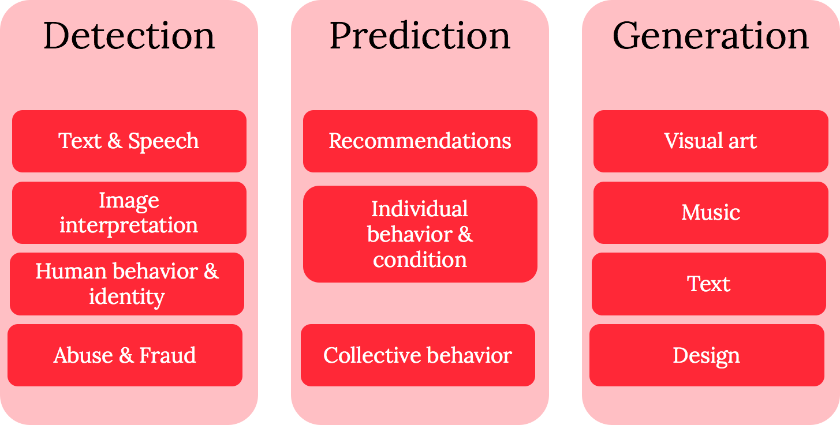
Three main areas where Deep learning is being prominently applied

Slide 13
Overview
The human brain computes in an entirely different way from the conventional digital computer.
The brain routinely accomplishes perceptual recognition in approximately
100-200 ms.
How does a human brain do it?

Slide 14
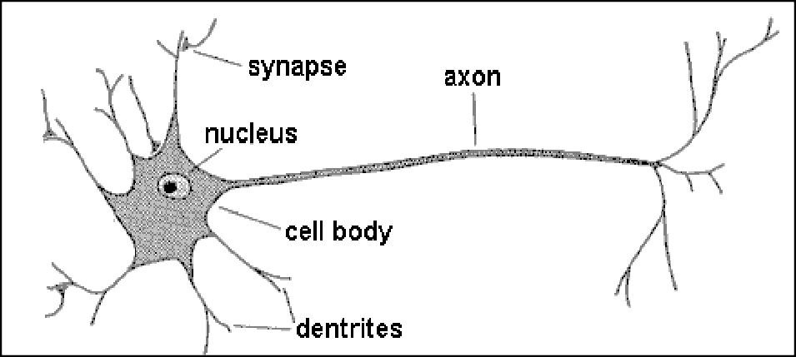
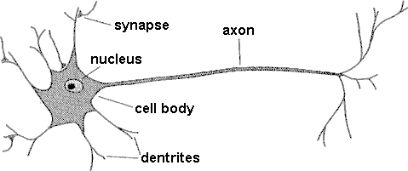
Biological neuron
dendrites
synapse
synapse axon
nucleus
cell body dendrites
axon
nucleus
cell body
A neuron has
A branching input (dendrites)
A branching output (the axon)
The information circulates from the dendrites to the axon via the cell body
Axon connects to dendrites via synapses
Synapses vary in strength

Slide 15
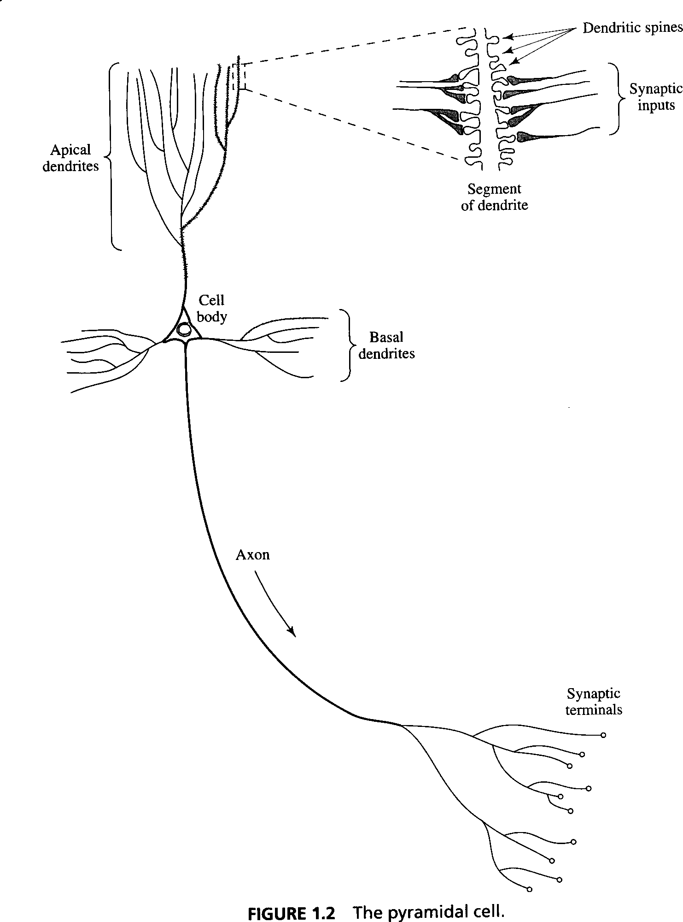

Biological Background
Synapses are elementary structural and functional units that mediate the interactions between neurons.

Slide 16
Definition
A neural network is a massive parallel distributed processor made up of simple processing units, which has a natural propensity for storing experimental knowledge and making it available for use. It resembles the brain in two respects:
1) Knowledge is acquired by the network from its environment through a learning process.
2) Interneuron connection strengths, known as synaptic weights, are used to store the acquired knowledge.

Slide 17

The Artificial Neuron
Bias
b
x₁
w₁
Activation function
Local Field v
∑
ϕ(−)
Output
y
x₂
w₂
Input values
⁝ ⁝
Summing function
x_{m}
w_{m}
weights

Slide 18
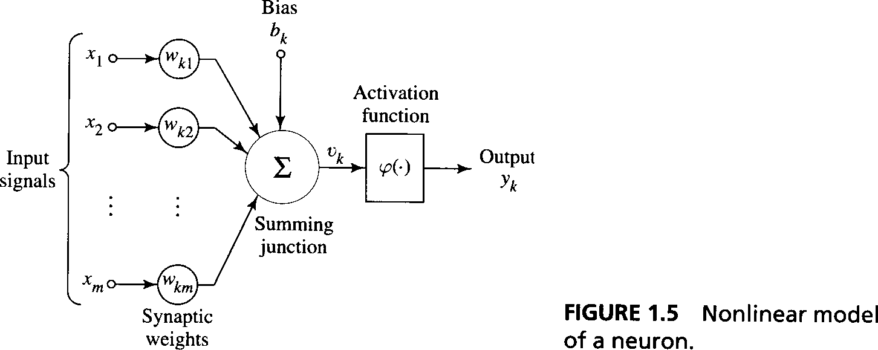
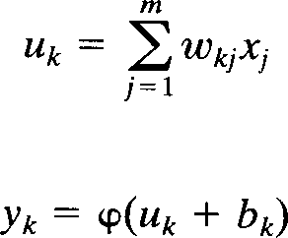
A model of a neuron:

Slide 19
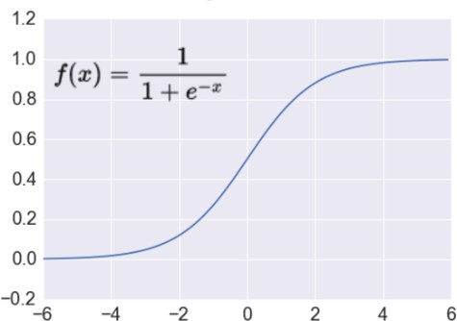
Activation: Sigmoid
Takes a real-valued number and “squashes” it into range between 0 and 1.
𝑅^{𝑛} → 0,1
http://adilmoujahid.com/images/activation.png
 Nice interpretation as the firing rate of a neuron
0 = not firing at all
1 = fully firing
− Sigmoid neurons saturate and kill gradients, thus NN will barely learn
when the neuron’s activation are 0 or 1 (saturate)
 gradient at these regions almost zero
 almost no signal will flow to its weights
 if initial weights are too large then most neurons would saturate

Slide 20
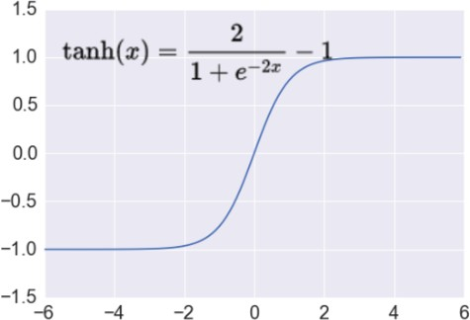
Activation: Tanh
Takes a real-valued number and “squashes” it into range between -1 and 1.
𝑅^{𝑛} → −1,1
http://adilmoujahid.com/images/activation.png
− Like sigmoid, tanh neurons saturate
− Unlike sigmoid, output is zero-centered
− Tanh is a scaled sigmoid: tanh 𝑥 = 2𝑠𝑖𝑔𝑚 2𝑥 − 1

Slide 21
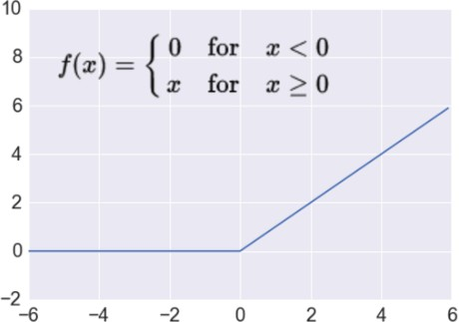
Activation: ReLU
Takes a real-valued number and
thresholds it at zero f 𝑥 = max(0, 𝑥)
𝑅^{𝑛} → 𝑅^{𝑛}
+
http://adilmoujahid.com/images/activation.png
Most Deep Networks use ReLU nowadays
Trains much faster
accelerates the convergence of SGD
due to linear, non-saturating form
Less expensive operations
compared to sigmoid/tanh (exponentials etc.)
implemented by simply thresholding a matrix at zero

Slide 22
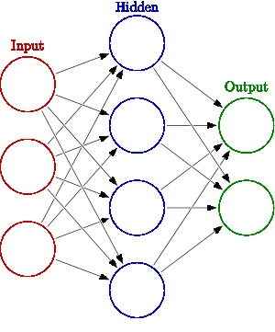



Neural Network Intro
Weights
𝒉 = 𝝈(𝐖_{𝟏}𝒙 + 𝒃_{𝟏})
𝒚 = 𝝈(𝑾_{𝟐}𝒉 + 𝒃_{𝟐})
Activation functions
How do we train?
𝒚
𝒙
4 + 2 = 6 neurons (not counting inputs)
[3 x 4] + [4 x 2] = 20 weights
4 + 2 = 6 biases
26 learnable parameters
𝒉

Slide 23
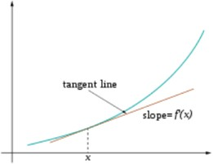
Training
Sample labeled data
(batch)
Forward it through the network, get predictions
Back- propagate the errors
Update the network weights
Optimize (min. or max.) objective/cost function 𝑱(𝜽) Generate error signal that measures difference between predictions and target values
Use error signal to change the weights and get more accurate predictions
Subtracting a fraction of the gradient moves you
towards the (local) minimum of the cost function
https://medium.com/@ramrajchandradevan/the-evolution-of-gradient-descend-optimization-algorithm-4106a6702d39

Slide 24





Loss functions and output
Classification Regression
R^{n} x {class_1, ..., class_n} R^{n} x R^{m} (one-hot encoding)
Training examples
Output Layer
Soft-max
[map R^{n} to a probability distribution]
Linear (Identity)
or Sigmoid
f(x)=x
Cost (loss)
function
Cross-entropy
Mean Squared Error
𝑛
1
𝐽 𝜃 =
_{∑ 𝑦}(𝑖) _{− 𝑦^}(𝑖)
𝑖=1
2
1
𝑛 𝐾
_{1 − 𝑦}(𝑖)
𝑛
𝐽 𝜃 = − ∑ ∑
𝑦^{(𝑖)} log 𝑦^^{(𝑖)} +
𝑘 𝑘
log 1 − 𝑦^ ^{𝑖}
𝑛
𝑘
𝑘
Mean Absolute Error
𝑛
𝑖=1 𝑘=1
𝐽 𝜃
1
_{= ∑ 𝑦}(𝑖) _{− 𝑦^}(𝑖)
𝑛
𝑖=1

Slide 25
How A Multi-Layer Neural Network Works?
The inputs to the network correspond to the attributes measured for each
training tuple
Inputs are fed simultaneously into the units making up the input layer
They are then weighted and fed simultaneously to a hidden layer
The number of hidden layers is arbitrary, although usually only one
The weighted outputs of the last hidden layer are input to units making up the output layer, which emits the network's prediction
The network is feed-forward in that none of the weights cycles back to an input unit or to an output unit of a previous layer
From a statistical point of view, networks perform nonlinear regression: Given enough hidden units and enough training samples, they can closely approximate any function

Slide 26
Backpropagation
Iteratively process a set of training tuples & compare the network's prediction with the actual known target value
For each training tuple, the weights are modified to minimize the mean squared error between the network's prediction and the actual target value
Modifications are made in the “backwards” direction: from the output layer, through each hidden layer down to the first hidden layer, hence “backpropagation”
Steps
Initialize weights (to small random #s) and biases in the network
Propagate the inputs forward (by applying activation function)
Backpropagate the error (by updating weights and biases)
Terminating condition (when error is very small, etc.)

Slide 27
A Multi-Layer Feed-Forward Neural
Network
Output vector
1
1+ e^{− Ik}
O =
Output layer
k
Err_{k} = Ok(1− O_{k} )(T_{k} − O_{k} )
^{w}jk
= w_{jk} + (l)Err_{k} O_{j}
I_{k} = ∑ w_{jk} Oj +θ_{k}
i
θ_{k} =θ_{k} + (l )Err_{k}
^{w}jk
Hidden layer
Err_{j} = O_{j} (1− O_{j} )∑ Err_{k} w_{jk}
1
1+ e
O =
k
j
−I
j
w_{ij} = w_{ij} + (l)Err_{j}O_{i}
^{w}ij
θ _{j} = θ _{j} + (l)Err_{j}
I _{j} = ∑ w_{ij}O_{i} +θ _{j}
i
Input layer
Input vector: X

Slide 28
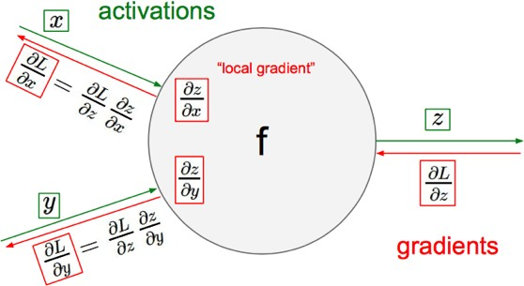
Gradient Descent
objective/cost function 𝑱(𝜽)
_{𝜃}𝑛𝑒𝑤 _{= 𝜃}𝑜𝑙𝑑
𝑗 𝑗
ⅆ
−
_{ⅆ𝜃}𝑜𝑙𝑑
𝐽(𝜃) Update each element of θ
𝑗
_{𝜃}𝑛𝑒𝑤 _{= 𝜃}𝑜𝑙𝑑
− ❑_{𝜃}𝐽(𝜃)
Matrix notation for all parameters
learning rate
Recursively apply chain rule though each node

Slide 29

One forward pass
Text (input) representation
TFIDF
Word embeddings
….
0.2 | -0.5 | 0.1
2.0 | 1.5 | 1.3
0.5 | 0.0 | 0.25
-0.3 | 2.0 | 0.0
0.1
0.2
0.3
1.0
3.0
0.025
0.0
0.95
3.89
0.15
0.37
positive
very positive negative
very negative
𝐖
𝒙_{𝒊}
𝒃
𝝈(𝒙_{𝒊}; 𝑾, 𝒃)

Slide 30
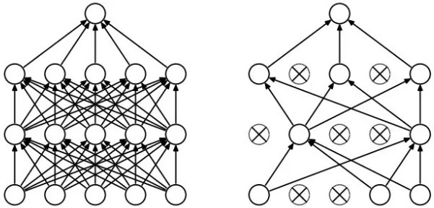
Regularization
Dropout
Randomly drop units (along with their connections) during training
Each unit retained with fixed probability p, independent of other units
Hyper-parameter p to be chosen (tuned)
Srivastava, Nitish, et al. "Dropout: a simple way to prevent neural
networks from overfitting." Journal of machine learning research (2014)
L2 = weight decay
Regularization term that penalizes big weights, objective
added to the
^{𝐽}𝑟𝑒𝑔
𝜃 = 𝐽 𝜃 + 𝜆 ∑ 𝜃²
Weight decay value determines how dominant regularization is during gradient computation
Big weight decay coefficient → big penalty for big weights
𝑘
𝑘
Early-stopping
Use validation error to decide when to stop training
Stop when monitored quantity has not improved after n subsequent epochs
n is called patience

Slide 31
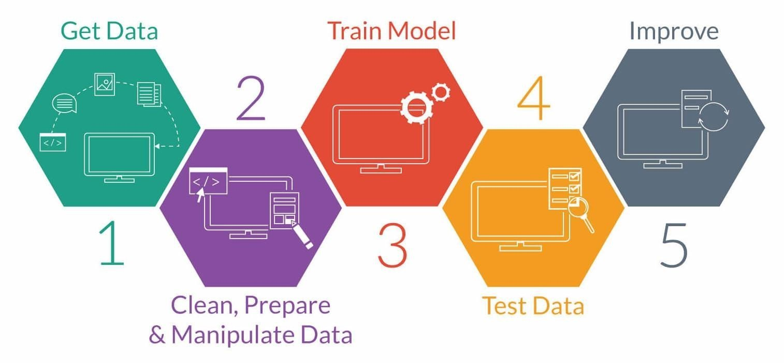
25 June
2018
leadingindia.ai A nationwide AI Skilling and Research Initiative
1
9

Slide 32
Essential Tools
Git and Github
Python
Jupyter Notebooks
Numpy for Matrix and Vector calculations
Pandas for Data handling, curation and manipulation
Matplotlib for plotting of graphs for different analysis on data
Scikit-learn
keras
So many other Python APIs to make your life easy to develop DL models

Slide 33















Neural Network with one hidden Neuron and one hidden layer
w₁
Credit Score
x₁
Geography
x₂
w
2
Activation Function
Exit
w₃
z₁
g(z₁)
ŷ
Gender
x₃
w₄
z₁= x₁w₁+ x₂w₂+ x₃w₃+x₄w₄+ x₅w₅+ b
Age
x₄
Ŷ=g(W^{T}X+b)
w
b
Tenure
`
x₅
1

Slide 35
References
Srivastava, Nitish, et al. "Dropout: a simple way to prevent neural networks from overfitting." Journa
learning research (2014)
Bergstra, James, and Yoshua Bengio. "Random search for hyper-parameter optimization." Journal of Machine Learning Research, Feb (2012)
Kim, Y. “Convolutional Neural Networks for Sentence Classification”, EMNLP (2014)
Severyn, Aliaksei, and Alessandro Moschitti. "UNITN: Training Deep Convolutional Neural Network for Twitter Sentiment Classification." SemEval@ NAACL-HLT (2015)
Cho, Kyunghyun, et al. "Learning phrase representations using RNN encoder-decoder for statistical machine translation." EMNLP (2014)
Ilya Sutskever et al. “Sequence to sequence learning with neural networks.” NIPS (2014)
Bahdanau et al. "Neural machine translation by jointly learning to align and translate." ICLR (2015)
Gal, Y., Islam, R., Ghahramani, Z. “Deep Bayesian Active Learning with Image Data.” ICML (2017)
Nair, V., Hinton, G.E. “Rectified linear units improve restricted boltzmann machines.” ICML (2010)
Ronan Collobert, et al. “Natural language processing (almost) from scratch.” JMLR (2011)
Kumar, Shantanu. "A Survey of Deep Learning Methods for Relation Extraction." arXiv preprint arXiv:1705.03645 (2017)
Lin et al. “Neural Relation Extraction with Selective Attention over Instances” ACL (2016) [code]
Zeng, D.et al. “Relation classification via convolutional deep neural network”. COLING (2014)
Nguyen, T.H., Grishman, R. “Relation extraction: Perspective from CNNs.” VS@ HLT-NAACL. (2015)
Zhang, D., Wang, D. “Relation classification via recurrent NN.” -arXiv preprint arXiv:1508.01006 (2015)
Zhou, P. et al. “Attention-based bidirectional LSTM networks for relation classification . ACL (2016)
l of machine

Slide 36
References & Resources
http://web.stanford.edu/class/cs224n
https://www.coursera.org/specializations/deep-learning
https://chrisalbon.com/#Deep-Learning
http://www.asimovinstitute.org/neural-network-zoo
http://cs231n.github.io/optimization-2
https://medium.com/@ramrajchandradevan/the-evolution-of-gradient-descend-optimization-algorithm- 4106a6702d39
https://arimo.com/data-science/2016/bayesian-optimization-hyperparameter-tuning
http://www.wildml.com/2015/12/implementing-a-cnn-for-text-classification-in-tensorflow
http://www.wildml.com/2015/11/understanding-convolutional-neural-networks-for-nlp
https://medium.com/technologymadeeasy/the-best-explanation-of-convolutional-neural-networks-on-the- internet-fbb8b1ad5df8
http://www.wildml.com/2015/09/recurrent-neural-networks-tutorial-part-1-introduction-to-rnns/
http://www.wildml.com/2015/10/recurrent-neural-network-tutorial-part-4-implementing-a-grulstm-rnn-with- python-and-theano/
http://colah.github.io/posts/2015-08-Understanding-LSTMs
https://github.com/hyperopt/hyperopt
https://github.com/tensorflow/nmt

Slide 37


